Slide 1

Plan for Analysis of Recursive Algorithms
Decide on a parameter indicating an input’s size.
Identify the algorithm’s basic operation.
Check whether the number of times the basic operation is executed may vary on different inputs of the same size. (If it may, the worst, average, and best cases must be investigated separately.)
Set up a recurrence relation with an appropriate initial condition expressing the number of times the basic operation is executed.
Solve the recurrence by backward substitutions or other methods, and determine the efficiency class.

Slide 2
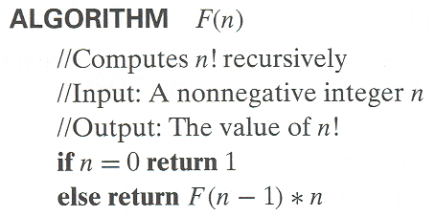
Example: Recursive Evaluation of n!
Non-recursive definition: n ! = 1 ∗ 2 ∗ … ∗(n-1) ∗ n for n ≥ 1 and 0! = 1
Recursive definition of n!: F(n) = F(n-1) ∗ n for n ≥ 1 and F(0) = 1
F(4)
24 4 ∗ F(3)
6 3 ∗ F(2)
2 2 ∗ F(1)
1 1 ∗ F(0)
1
Notes:
Note the difference between the two recurrences. Students often confuse these!
F(n) = F(n-1) n
F(0) = 1
for the values of n!
------------
M(n) =M(n-1) + 1
M(0) = 0
for the number of multiplications made by this algorithm

Slide 3
Example: Recursive Evaluation of n!
Non-recursive definition: n ! = 1 ∗ 2 ∗ … ∗(n-1) ∗ n for n ≥ 1 and 0! = 1
Recursive definition of n!: F(n) = F(n-1) ∗ n for n ≥ 1 and F(0) = 1
F(4)
24 4 ∗ F(3)
6 3 ∗ F(2)
2 2 ∗ F(1)
1 1 ∗ F(0)
Input: n 1
Basic operation: multiplication
Worst, average, best cases: No
Notes:
Note the difference between the two recurrences. Students often confuse these!
F(n) = F(n-1) n
F(0) = 1
for the values of n!
------------
M(n) =M(n-1) + 1
M(0) = 0
for the number of multiplications made by this algorithm

Slide 4
Example: Recursive Evaluation of n!
Non-recursive definition: n ! = 1 ∗ 2 ∗ … ∗(n-1) ∗ n for n ≥ 1 and 0! = 1
Recursive definition of n!: F(n) = F(n-1) ∗ n for n ≥ 1 and F(0) = 1
F(4)
24 4 ∗ F(3)
M(4) 6 3 ∗ F(2)
= 1+M(3) M(3) 2 2 ∗ F(1)
= 4 = 1+M(2) M(2) 1 1 ∗ F(0)
= 3 = 1+M(1) M(1) 1
= 2 = 1+M(0) M(0)=0
= 1
Notes:
Note the difference between the two recurrences. Students often confuse these!
F(n) = F(n-1) n
F(0) = 1
for the values of n!
------------
M(n) =M(n-1) + 1
M(0) = 0
for the number of multiplications made by this algorithm

Slide 5
Example: Recursive Evaluation of n!
Non-recursive definition: n ! = 1 ∗ 2 ∗ … ∗(n-1) ∗ n for n ≥ 1 and 0! = 1
Recursive definition of n!: F(n) = F(n-1) ∗ n for n ≥ 1 and F(0) = 1
F(4)
24 4 ∗ F(3)
M(4) 6 3 ∗ F(2)
= 1+M(3) M(3) 2 2 ∗ F(1)
= 4 = 1+M(2) M(2) 1 1 ∗ F(0)
= 3 = 1+M(1) M(1) 1
= 2 = 1+M(0) M(0)=0 M(n) = 1 + M(n-1)
= 1 M(0) = 0
Notes:
Note the difference between the two recurrences. Students often confuse these!
F(n) = F(n-1) n
F(0) = 1
for the values of n!
------------
M(n) =M(n-1) + 1
M(0) = 0
for the number of multiplications made by this algorithm

Slide 6
Recurrence Relations for Algorithm Analysis
A sequence is of the form
x(1), x(2), x(3), ... (1)
A generic term of a sequence can be expressed as
x(n). (2)
In analysis of an algorithm, x(i) (i ≥ 1) can be used to represent the number of times the algorithm’s basic operation is executed when the input size is i.

Slide 7
Recurrence Relations for Algorithm Analysis
A recurrence (or recurrence relation or recurrence equation) is an equation which relates the generic term of a sequence with one or more other terms of the same sequence, for example,
x(n) = x(n − 1) + 1, for n > 0 (3)
x(0) = 0 (4)
where (3) is a recurrence and (4) is its initial condition.

Slide 8
Set Up a Recurrence Relation
To set up a recurrence for C(n), the number of times the basic operation is executed,
we can first set up the recurrence for the algorithm, based on the problem definition or description, for example,
F(n) = n ∗ F(n − 1), for n > 0 (5)
F(0) = 1, for n = 0. (6)
then we can have the recurrence of C(n) which counts the number of times the basic operation is executed in the above recurrence (5). For example, when the basic operation is multiplication
M(n) = 1 + M(n − 1), for n > 0. (7)
M(0) = 0, for n = 0. (8)

Slide 9
Solving a Recurrence Relation
Solving a recurrence equation subject to an initial condition is to find an explicit formula for the generic term of the sequence that satisfies both the recurrence and the initial condition, or to prove such a sequence does not exist.
In a solution, the left-hand side is the generic term of the sequence, and the right-hand side does not include any term of the sequence. Solutions are like x(n) = n, or x(n) = [n(n + 1)]/2.
Solving a recurrence is to eliminate any sequence term on the right-hand side.
Backward substitution is an effective method for solving recurrences.

Slide 10

Methods of Backward Substitution
Two methods of backward substitution
Method 1 is used to solve recurrences of the form
x(n) = ax(n-1) + f(n)
where a is an integer, a $≥$ 1 and f(n) is a function of n.
Method 2 is used to solve recurrences of the form
x(n) = ax(n/b) + f(n)
where a and b are integers, a$≥$1, b$≥$2, and f(n) is a function of n.

Slide 11
Methods of Backward Substitution
Backward Substitution Method 1
This method is used to solve recurrences of the form x(n) = ax(n-1) + f(n).
Example recurrence and initial condition:
x(n) = x(n-1) + 1 (3)
x(0) = 0 (4)
Start with the recurrence equation in (3).
Express x(n) in terms of x(n − 2):
1. Express x(n − 1) in terms of x(n − 2):
x(n − 1) = x(n − 2) + 1 (9)
2. Substitute (9) into (3) and simplify
x(n) = [x(n − 2) + 1] + 1 = x(n − 2) + 2 (10)

Slide 12
Methods of Backward Substitution
Backward Substitution Method 1 (cont.)
We have expressed x(n) in terms of x(n-2) in previous step:
x(n) = x(n − 2) + 2 (10)
Then express x(n) in term of x(n − 3):
1. Express x(n − 2) in term of x(n − 3):
x(n − 2) = x(n − 3) + 1 (11)
2. Substitute (11) into (10) to obtain
x(n) = [x(n − 3) + 1] + 2 = x(n − 3) + 3 (12)
And then, if necessary, express x(n) in terms of x(n − 4) and so on.

Slide 13
Methods of Backward Substitution
Backward Substitution Method 1 (cont.)
We have: x(n) = x(n − 1) + 1 (3)
x(n) = x(n − 2) + 2 (10)
x(n) = x(n − 3) + 3 (12)
Examining (3), (10), (12) and others (if there are), we can discover a pattern of them:
x(n) = x(n − i) + i (13)
for 1 ≤ i ≤ n.

Slide 14
Methods of Backward Substitution
Backward Substitution Method 1 (cont.)
We have the general formula from the pattern:
x(n) = x(n − i) + i (13)
for 1 ≤ i ≤ n.
The next step is to eliminate the term x(n − i) from the right-hand side of (13).
Since the initial condition x(0) = 0 is for n = 0, we need n − i = 0, i.e. i = n, to eliminate the term of x(n − i) from (13). Let i = n. We obtain
x(n) = x(n − n) + n = x(0) + n = 0 + n = n (14)
x(n) = n is the solution of the recurrence (3) subject to its initial condition (4).

Slide 15
Methods of Backward Substitution
Backward Substitution Method 1 (cont.)
The process of solving the recurrence can be written as
x(n) = x(n-1) + 1 (sub. x(n-1) = x(n-2) + 1)
= [x(n-2) + 1] + 1 = x(n-2) + 2 (sub. x(n-2) = x(n-2) + 1)
= [x(n-3) + 1] + 2 = x(n-3) + 3
...
= x(n-i) + i (sub. i = n)
= x(0) + n (sub. Initial condition x(0) = 0)
= n

Slide 16
Methods of Backward Substitution
In-class exercise:
Solve the following recurrence subject to the initial condition
x(n) = x(n-1) + 3 for n > 0
x(0) = 1

Slide 17
Methods of Backward Substitution
Solution to in-class exercise
x(n) = x(n-1) + 3 (sub. x(n-1) = x(n-2) + 3)
= [x(n-2) + 3] + 3 = x(n-2) + 6 (sub. x(n-2) = x(n-3) + 3)
= [x(n-3) + 3] + 6 = x(n-3) + 9
...
= x(n-i) + 3i (sub. i = n)
= x(0) + 3n (sub. Initial condition x(0) = 1)
= 3n + 1

Slide 18
Example: The Tower of Hanoi Puzzle
Move all the disks from peg A to peg C, using peg B as auxiliary.
Move one disk at a time.
It is not allow to place a larger disk on top of a smaller disk.
1
2
3
4
5
6
A B C

Slide 19
Example: The Tower of Hanoi Puzzle
Move all the disks from peg A to peg C, using peg B as auxiliary.
Move one disk at a time.
It is not allow to place a larger disk on top of a smaller disk.
1
2
3
4
5
6
A B C
move (topDisk, #ofDiskToMove, fromPeg, toPeg)
move (1, n, A, C) ← move(1, n-1, A, B), move (n, 1, A, C),
move(1, n-1, B, C)
1
2
3

Slide 20
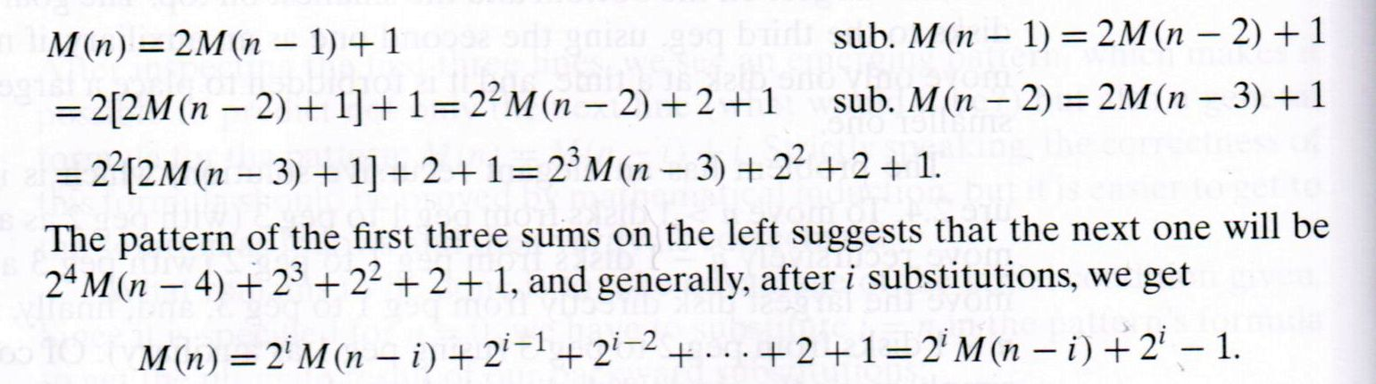
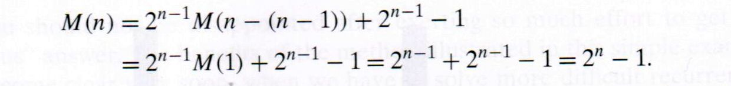

Solving Recurrence for Number of Moves
move (1, n, A, C) ← move(1, n-1, A, B), move (n, 1, A, C), move(1, n-1, B, C)
M(n) = M(n-1) + 1 + M(n-1), M(1) = 1
M(n) = 2M(n-1) + 1, M(1) = 1
Input size: n
Basic operation: moving a disk
No worst, average, best cases
$2^{i−1}$+ $2^{i−2}$+ … +$2+1$
= $\sum_{j=0}^{i−1}{2^{j}}$ = $2^{i}−1$
$2^{n−1}$+ $2^{n−1}$ = $2×$ $2^{n−1}$
= $2^{n−1+1}$ = $2^{n}$
Sub. i = n - 1:

Slide 21
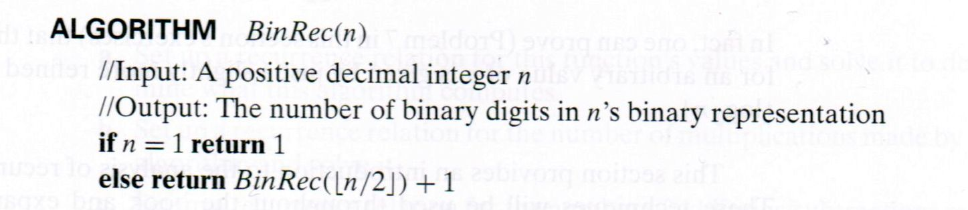

Example: Number of Binary Digits
BinRec(7) = BinRec$\left(\left\lfloor \frac{7}{2}\right\rfloor \right)+1$
= BinRec(3) + 1
= (BinRec$\left(\left\lfloor \frac{3}{2}\right\rfloor \right)$+1) + 1
= BinRec(1) + 1 + 1
= 1 + 1 + 1
= 3
$7_{10}$ = ${111}_{2}$

Slide 22

Example: Number of Binary Digits
BinRec(7) = BinRec$\left(\left\lfloor \frac{7}{2}\right\rfloor \right)+1$
= BinRec(3) + 1
= (BinRec$\left(\left\lfloor \frac{3}{2}\right\rfloor \right)$+1) + 1
= BinRec(1) + 1 + 1
= 1 + 1 + 1
= 3
$7_{10}$ = ${111}_{2}$
Input size: n
Basic operation: addition
No worst, best, average cases
Recurrence and initial condition:
A(n) = $A\left(\left\lfloor \frac{n}{2}\right\rfloor \right)+1$ for n > 1
A(1) = 0

Slide 23

Methods of Backward Substitution
Backward Substitution Method 2
This method can be used to solve recurrences of the form of
x(n) = ax(n/b) + f(n)
where a $≥$ 1, b $≥$ 2, and f(n) is a function of n.
The example recurrence and initial condition are:
x(n) = x(n/2) + 1 for n > 1 (1)
x(1) = 0 (2)
Solve for n = $2^{k}$, and rewrite (1) and (2) as the following
x($2^{k}$) = x($2^{k−1}$) + 1 for k > 0 (3)
x($2^{0}$) = 0 (4)

Slide 24

Methods of Backward Substitution
Backward Substitution Method 2 (cont.)
The recurrence to be solved is
x($2^{k}$) = x($2^{k−1}$) + 1 for k > 0 (3)
Express x($2^{k}$) in terms of x($2^{k−2}$):
1. Express x($2^{k−1}$) in terms of x($2^{k−2}$):
x($2^{k−1}$) = x($2^{k−2}$) + 1 (4)
2. Substitute (4) into (3) to obtain
x($2^{k}$) = [x($2^{k−2}$) + 1] + 1 = x($2^{k−2}$) + 2 (5)

Slide 25

Methods of Backward Substitution
Backward Substitution Method 2 (cont.)
In the previous step, we obtained
x($2^{k}$) = [x($2^{k−2}$) + 1] + 1 = x($2^{k−2}$) + 2 (5)
Then express x($2^{k}$) in term of x($2^{k−3}$):
1. Express x($2^{k−2}$) in term of x($2^{k−3}$):
x($2^{k−2}$) = x($2^{k−3}$) + 1 (6)
2. Substitute (6) into (5) to obtain
x($2^{k}$) = [x($2^{k−3}$) + 1] + 2 = x($2^{k−3}$) + 3 (7)
And then, if necessary, express x($2^{k}$) in terms of x($2^{k−4}$) and so on.

Slide 26

Methods of Backward Substitution
Backward Substitution Method 2 (cont.)
We have
x($2^{k}$) = x($2^{k−1}$) + 1 (3)
x($2^{k}$) = x($2^{k−2}$) + 2 (5)
x($2^{k}$) = x($2^{k−3}$) + 3 (7) Examining (3), (5), and (7), we discover a pattern and express it in
x($2^{k}$) = x($2^{k−i}$) + i (8)
for 1 ≤ i ≤ k.

Slide 27

Methods of Backward Substitution
Backward Substitution Method 2 (cont.)
We have the general formula for the pattern
x($2^{k}$) = x($2^{k−i}$) + i (8)
The next is to eliminate x($2^{k−i}$) from the right-hand side of (8) using x($2^{0}$) = 0.
Since the initial condition is x($2^{0}$) = 0, we need k − i = 0, i.e. i = k, to eliminate x($2^{k−i}$) from (8). Let i = k. We obtain
x($2^{k}$) = x($2^{k−k}$) + k = x($2^{0}$) + k = k or
x($2^{k}$) = k (9) Since n = $2^{k}$, we have k = $\log_{2}{n}$. (9) can be rewritten as x(n) = $\log_{2}{n}. This$ is the solution to recurrence (1) subject to initial condition (2).

Slide 28

Methods of Backward Substitution
The process of solving the recurrence can be written as
x(n) = x(n/2) + 1 (sub. n = $2^{k})$
x($2^{k}$) = x($2^{k−1})+1$ (sub. x($2^{k−1}$) = x($2^{k−2}$) + 1)
= [x($2^{k−2}$) + 1] + 1 = x($2^{k−2}$) + 2 (sub. x($2^{k−2}$) = x($2^{k−3}$) + 1)
= [x($2^{k−3}$) + 1] + 2 = x($2^{k−3}$) + 3
...
= x($2^{k−i}$) + i (sub. i = k)
= x($2^{k−k}$) + k = x($2^{0}$) + k = x(1) + k (sub. Initial condition x(1) = 0)
= k (sub. k = $\log_{2}{n}$)
= $\log_{2}{n}$

Slide 29
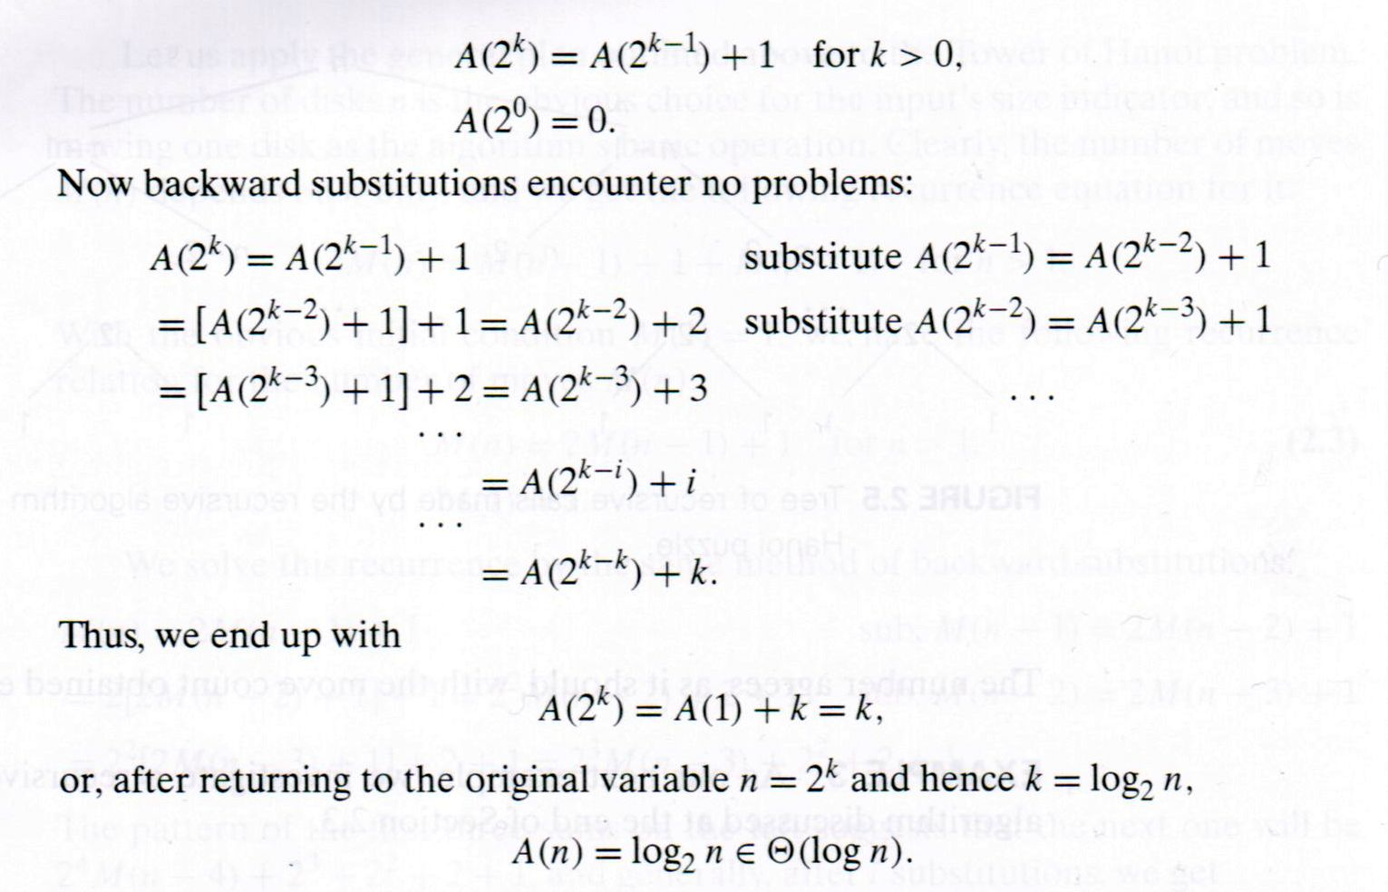

Example: Number of Binary Digits
BinRec(8) = BinRec$\left(\left\lfloor \frac{8}{2}\right\rfloor \right)+1$
= BinRec(4) + 1
= (BinRec$\left(\left\lfloor \frac{4}{2}\right\rfloor \right)$+1) + 1
= BinRec(2) + 1 + 1
= (BinRec$\left(\left\lfloor \frac{2}{2}\right\rfloor \right)$+1) + 1 + 1
= BinRec(1) + 1 + 1 + 1
= 1 + 1 + 1 + 1
= 4
4 digits in $8_{10}$ = ${1000}_{2}$
$\log_{2}{8}=3$ additions to calculate
BinRec(8)
substitute i=k

Slide 30

Methods of Backward Substitution
In-class exercise:
Solve the following recurrence for n = $2^{k}$, subject to the initial condition. Determine the efficiency class of the solution.
x(n) = x(n/2) + 3 for n > 0
x(1) = 0

Slide 31

Methods of Backward Substitution
Solution to in-class exercise
x(n) = x(n/2) + 3 (sub. n = $2^{k})$
x($2^{k}$) = x($2^{k−1})+3$ (sub. x($2^{k−1}$) = x($2^{k−2}$) + 3)
= [x($2^{k−2}$) + 3] + 3 = x($2^{k−2}$) + 6 (sub. x($2^{k−2}$) = x($2^{k−3}$) + 3)
= [x($2^{k−3}$) + 3] + 6 = x($2^{k−3}$) + 9
...
= x($2^{k−i}$) + 3i (sub. i = k)
= x($2^{k−k}$) + 3k = x($2^{0}$) + 3k = x(1) + 3k (sub. Initial condition x(1) = 0)
= 3k (sub. k = $\log_{2}{n}$)
= 3 $\log_{2}{n}$ $∈$ Θ($\log{n}$)

Slide 32




The Smoothness Rule
Eventually Non-decreasing Function
Let f($n$) be a non-negative function defined on the set of natural numbers. f($n$) is called eventually non-decreasing if there exists some non-negative integer $n_{0}$so that f($n$) is non-decreasing on the interval of [$n_{0}$,∞), i.e.
f($n_{1}$) ≤ f($n_{2}$) for any $n_{0}$≤ $n_{1}$≤ $n_{2}$.
For example, 1, $\log{n}$, $n$, $n\log{n}$, $n^{2}$ are eventually non-decreasing.
f($n$)
0,0
$$n_{0}$$
$$n$$

Slide 33

The Smoothness Rule
Smoothness
Let f($n$) be a non-negative function defined on the set of natural numbers. f($n$) is called smooth if it is eventually non-decreasing and
f(2$n$) ∈Θ(f($n$)).
For example, f($n$) = $\log_{2}{n}$ is smooth, because $\log_{2}{n}$ is eventually non-decreasing, and
f(2$n$) = $\log_{2}{(2n)}$= 1 + $\log_{2}{n}$∈Θ($\log{n}$).
Fast growing functions, such as $a^{n}$ where $a$ > 1 and $n$!, are not smooth. For example, f($n$) = $2^{n}$ is not smooth, because
f(2$n$) = $2^{2n}$= $2^{2^{n}}$ = $4^{n}$ $∉$Θ($2^{n}$).
Let f($n$) be a smooth function. For any fixed integer b ≥ 2,
f(b$n$) ∈Θ(f($n$)).

Slide 34

The Smoothness Rule
Smoothness rule: Let T($n$) be an eventually non-decreasing function and f($n$) be a smooth function. If
T($n$) ∈ Θ(f($n$))
Is true for values of $n$ that are powers of b (b ≥ 2), then
T($n$) ∈ Θ(f($n$))
Is also true for any values of $n$.

Slide 35

The Smoothness Rule
Smoothness rule in algorithm analysis
Let T($n$) be the number of repetitions of basic operation of an algorithm. T($n$) is an eventually nondecreasing function.
Basic efficiency classes $n^{d}$ and $n^{d}\log{n}$ are smooth functions, where d is an integer greater than or equal to 0.
When analyzing an algorithm, if T($n$) ∈ Θ(f($n$)) is true for $n$ = $2^{k}$, T($n$) ∈ Θ(f($n$)) is also true for any $n$ values, where f($n$) is $n^{d}$ or $n^{d}\log{n}$, and k is a positive integer,

Slide 36
Empirical analysis of time efficiency
Select a specific (typical) sample of inputs
Use physical unit of time (e.g., milliseconds)
or
Count actual number of basic operation’s executions
Analyze the empirical data (the recorded running time or number of basic operation’s executions).

Slide 37
Recommended Reading
2.4
2.6

